Slide 1

Tracking Reddit User Interests Over Time
Wendy Li, Hao Mao, Hao-Hsiang Song

Slide 2


1 Background
Reddit is an American social news aggregation and discussion website
Past OSN studies focus on content quality and popularity
Link prediction papers aim solely in network growth
Research in the two realms failed to account for one another
Notes:
Our study is different in that we are tying these two topics of content and network toplogy together, monitoring network changes to determine users’ shift in interest
Furthermore, Reddit is especially interesting because it really isn’t the typical large scale Onlines Social Network.
It is discussion-forum based, consisting of users posting and reading about specific topics of interest, giving those posts comments, upvotes, or down votes.
Therefore, Reddit is very isolating, and you would expect to see users cluster together and stick to the same communitites of interest
December 2017 alone, Reddit obtained 1.7 billion unique visits

Slide 3
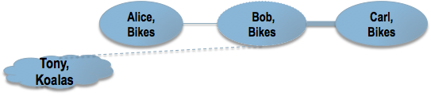

2 Our Approach
Parsed 5 year long Reddit dataset (2008-2013)
Graph construction of four month long snapshots
Performed community-level analysis via Louvain algorithm
Visualized and tracked user flows using Sankey diagram
Analyzed user interest shifts in terms of distribution of probabilities
Notes:
We started with a Reddit dataset consisting of HTML files of the posts with all the comments, upvotes, downvotes, usernames, and timestamps of interactions that spans a period of 5 years (2008-2013)
So, our dataset really starts immediately after Reddit went open-sourced in June 2008 after it began allowing users to create their own custom Reddits and Subreddits
We parsed this dataset, which consists of 132,308 submissions, for user-to-user interactions (i.e. a user commenting on another user’s post)
Group the user interactions based on timestamps, creating graphs for the four month long snapshot
Users serve as vertices and weighted edges between users as interactions/strength of interactions (number of times comment on each other’s post
In fact, in total our data has 6.2 million of edges with 642,035 unique users
Ran Louvain’s Algorithm each graph to identify communities in each snapshot
Visualized and tracked how users move from community to community across snapshots using a Sankey diagram
Finally, we analyzed the likelihood of users switching categories/interest from snapshot to snapshot
Like how common this phenomenon of switching interest communities is--maybe Users all stay in one interest community through time -- after all Reddit is a discussion forum, so that would be reasonable

Slide 4
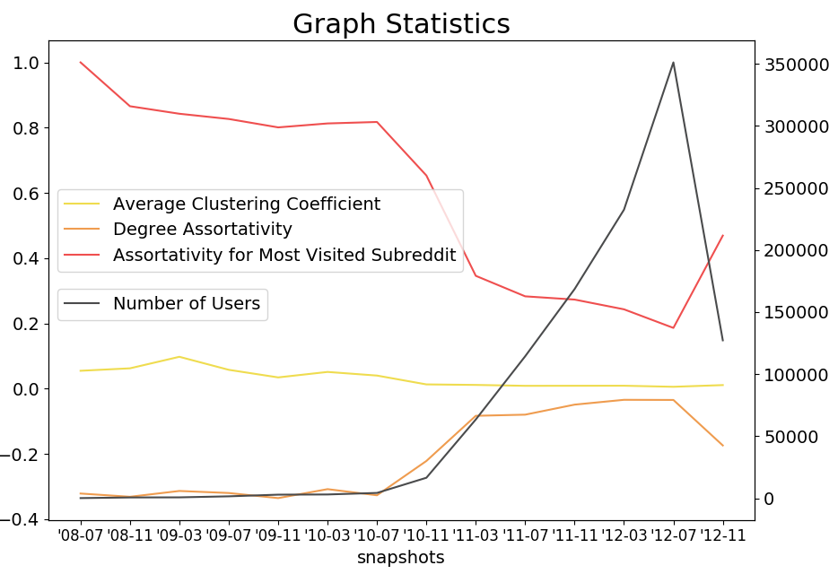
Network Statistics
High Assortativity for Most Visited Subreddit
Negatively correlated with the number of users
Average Clustering Coefficient higher than Twitter, but lower than Facebook
Notes:
As shown, interestingly, while the average degree assortativity in Reddit across the time period remains low, from around -0.34 to -0.03, the average assortativity for the most visited subreddits remain significantly higher, suggesting that popular users and categories tend to stick together. Furthermore, this assortativity drops by roughly 0.5 over 8 months. But, as indicate by the steep black line showing the number of active users, this drop is attributed to the explosion in user growth. Finally, Reddit’s average clustering coefficient of 3.3% suggests Reddit is not very tightly knit. Nevertheless, this coefficient is akin to OSNs like Twitter, Orkut, and Pokec, which have clustering coefficients of 2.15%, 4.13%, and 4.68%. It is slightly lower than that of Facebook’s, 8.51%. These clustering coefficients are somewhat significnt because other networks that are not OSNs have significantly different clustering coefficients. For instance, human social networks, real-world social networks between humans with offline ties, have much higher clustering coefficients, with some as high as 90.4%. Therefore, in these cluster coeffients, we can kind of see that maybe Reddit does act like a OSN.

Slide 5
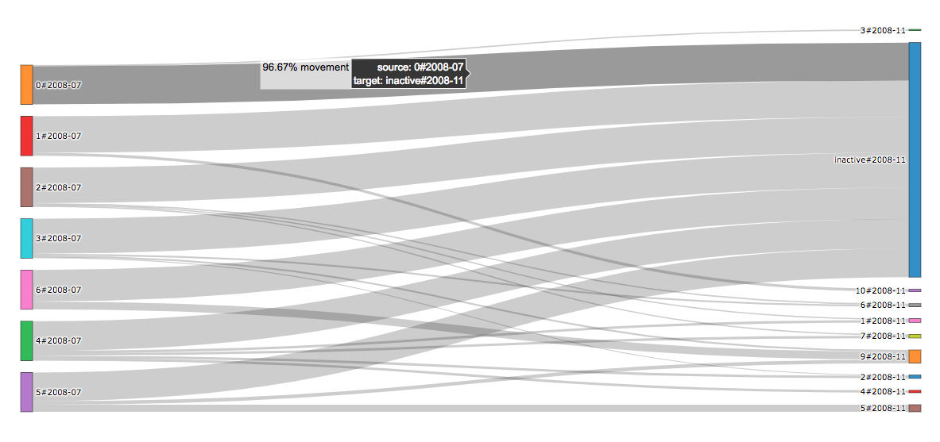
2.1 Visualization
Sankey graphs depicting flow between snapshots
Flow width depicts the continuity in same user interactions
Drop-out users marked inactive
Later snapshots generally have more clusters than early ones
Notes:
Because of the large scale of the network, tracking each individual user through each snapshot is not scalable
Moreover, because users act and interact based on interest communities, detections of these communities and visualizing changes in these clusters from snapshot to snapshot is much more informative
Towards this end, we use sankey graphs with an inactive bucket, with each graph depecting a flow between two consecutive snapshots
We use this inactive bucket because some users active in an earlier snapshot maybe inactive in a later one
In fact we find that especially in the early months of Reddit’s growth and development before it really takes off, there is high volatility in users, with high numbers like 89% of the entire user population droping out
So the garbage can visualizes the dropping out in terms of flow from one snapshot to the next consecutive snapshot
Drop-out users are marked inactive
The flow graphs are normalized
Later snapshots generally have more clusters than early ones
As shown in the example sankey graph of our earliest two snapshots, the lines or bars on the left side of the graph represent the communities in a snapshot of four months. The lines or bars on the right side of the graph represent the communities in the next snapshot of four months..
The clusters are normalized and the width of the flow leaving each cluster or bar corresponds to the percentage of users leaving that cluster going to a cluster or bar in the second second snapshot.
These interactive sankey graphs include the exact percentages of flow and the large blue cluster on right represents the flow of users that become inactive from the last snapshot to the next.

Slide 6
3 Key Findings
The network grows exponentially
1
↑ network size, ↑user retention rate, and interest communities stick together more frequently
2
Reddit is not only a discussion forum and OSN
3
Notes:
The network grows exponentially, expected of OSN
As the network gets bigger, use retain rate gets higher, and interest communities stick together more frequently
In addition, we can identify clear evolutions in user interest over time, with certain topics being added and deleted through time and other topics rising in popularity over time.
Finally, by analyzing user interest dynamics over time, we conclude that, unlike what intuition would suggest, Reddit acts not only as discussion forum, but also as an OSN.

Slide 7
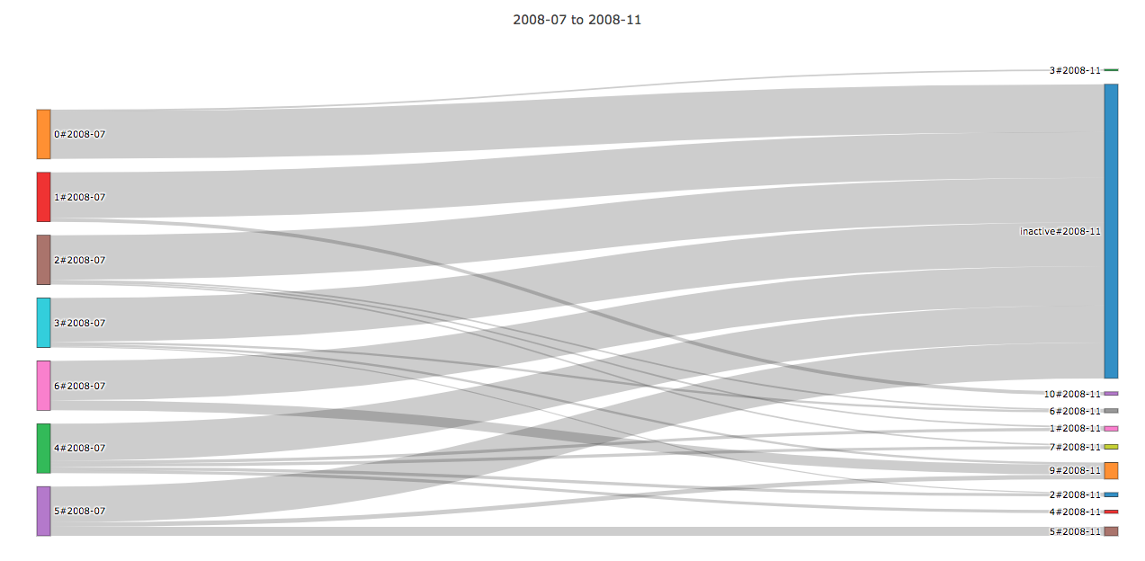
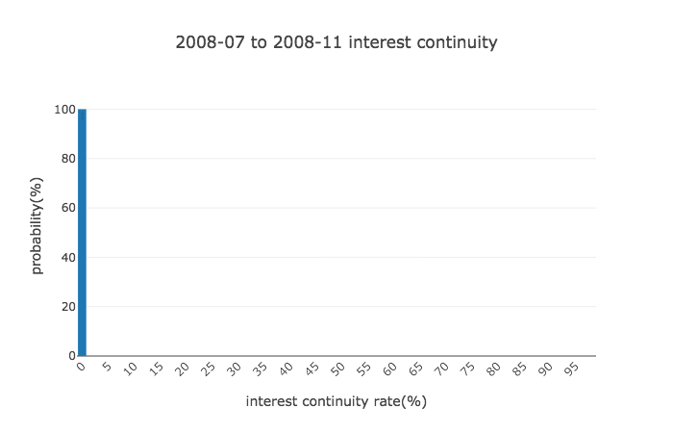
3.2 2008-07 to 2008-11 (Initial Era)
Notes:
We have this term interest continuity and what it means bla bla bla
Also, Sankey, as mentioned, characterizes the flow of users
Drop-out rate went so high as to 89% of the users in July 2008 snapshot
No indication that users remaining active flowed to cluster with the same interest
We define Interest continuity as user flow moving from one community to another community of the same interest or category and it is measured between two snapshots via flows.
This interest continuity graph about 100% of all the clusters will have 0% of interest continuity.

Slide 8
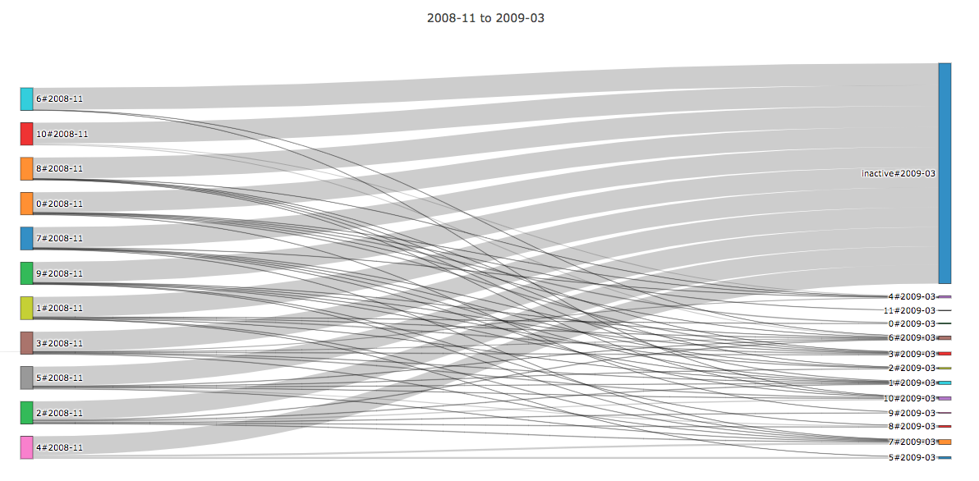
Outgoing Flow: 5.82
Users: <10,000
Notes:
The following snapshot (similar pattern)
The outgoing flow of 5.82 refers to the mean outgoing flow for all these source bars on the left. So the aver outgoing flow is 5.82 for these clusters

Slide 9
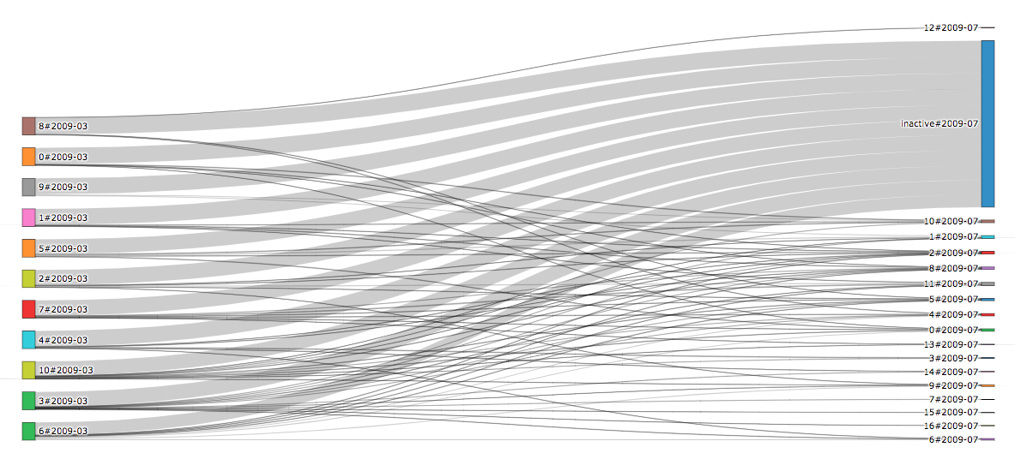
Outgoing Flow: 6.72
Users: <10,000
Notes:
The following snapshot (similar pattern)

Slide 10
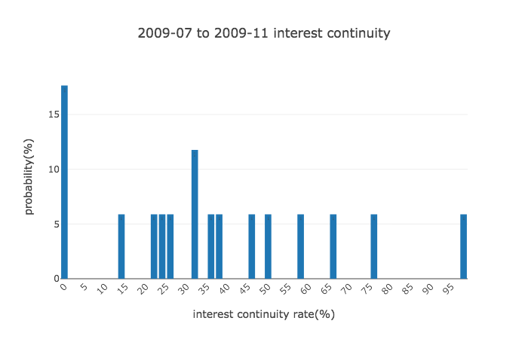
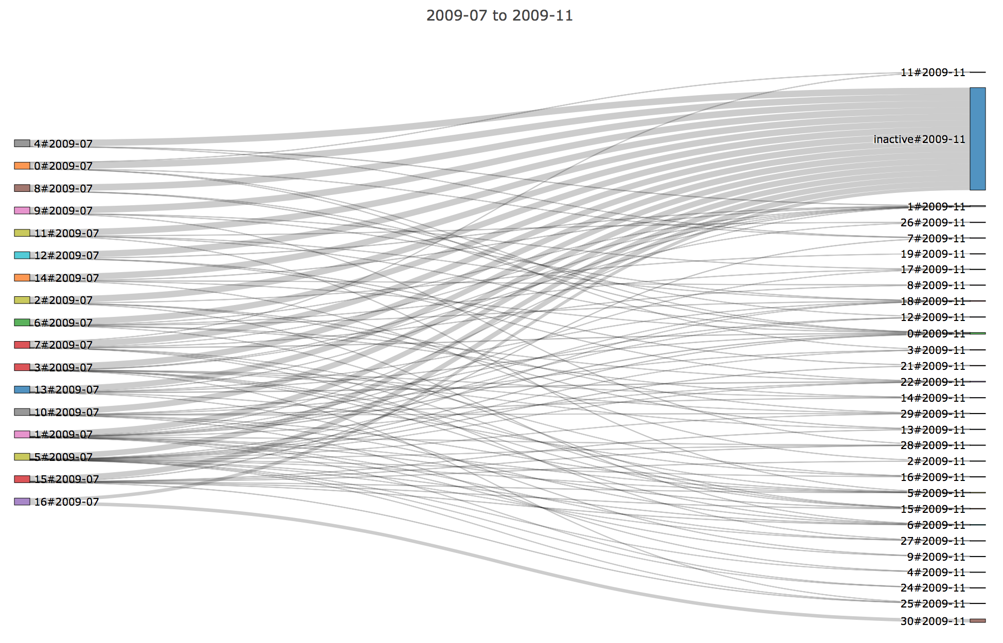
3.3 2009-07 to 2009-11 (Pre-Explosion Era)
Notes:
Finally, we come to what we term as the pre-explosion era
Here, we observed a drastic cluster growth
We also started seeing wider flows (50% and more) from clusters to clusters
Seeing much more diversity in interest continuity rate => that means users start adhering to cluster with same interest
For instance about 6% of the clusters will have 50% of the cluster shift interest

Slide 11
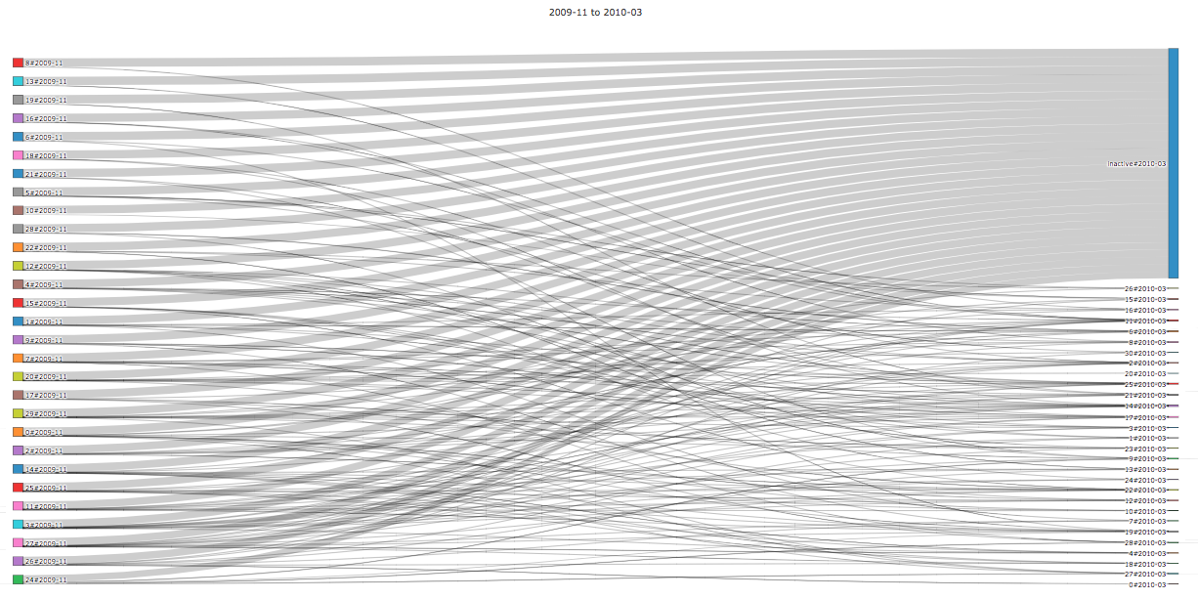
Outgoing Flow: 6.6
Users: <10,000
Notes:
The following snapshot (similar pattern)

Slide 12
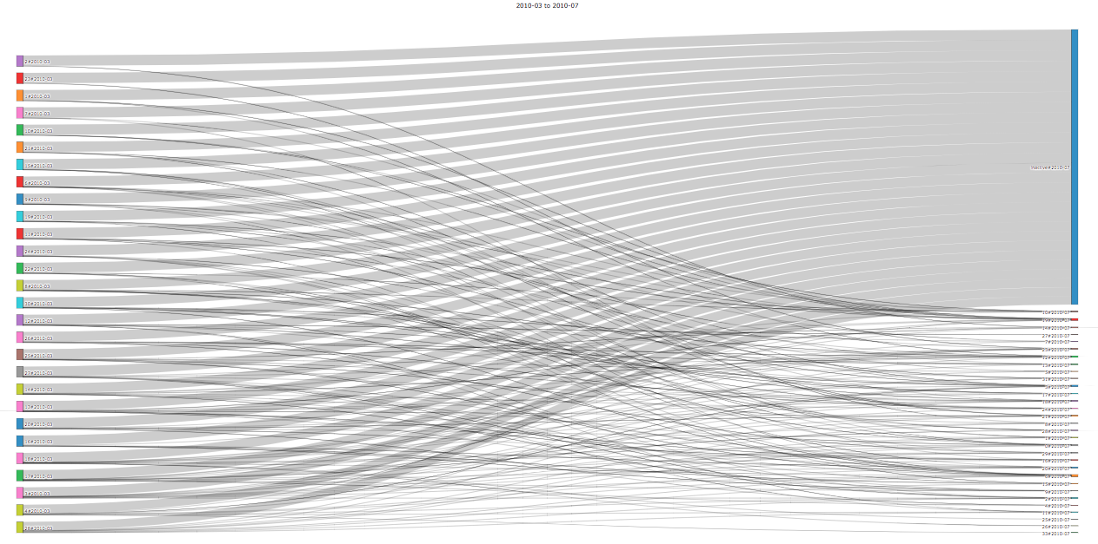
Outgoing Flow: 6.39
Users: <10,000
Notes:
The following snapshot (similar pattern)

Slide 13
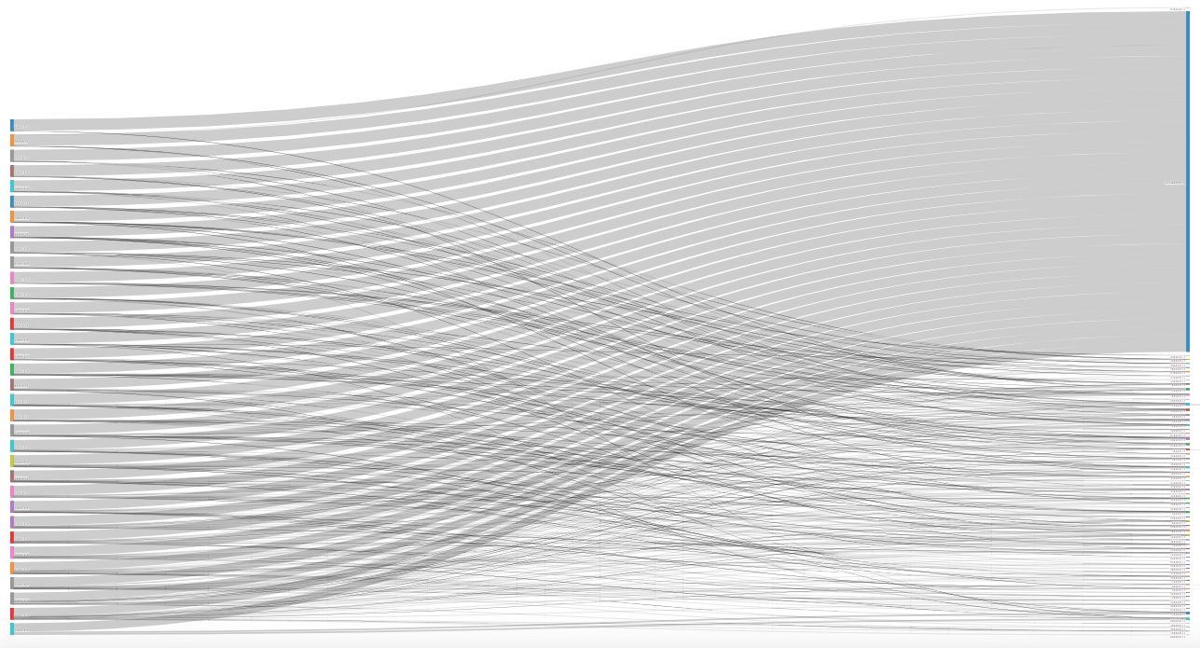
Outgoing Flow: 10.53
2010-07 to 2010-11
Users: <25,000
Notes:
The following snapshot (similar pattern)

Slide 14
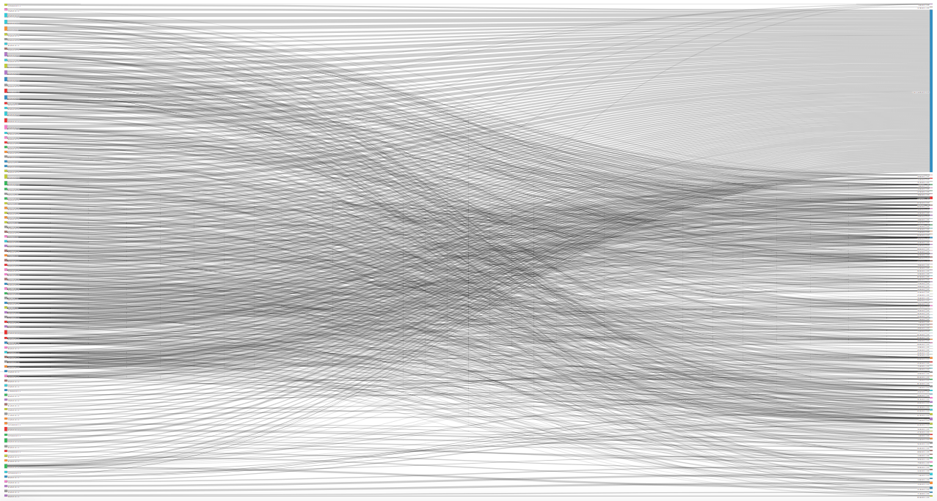
Outgoing Flow: 12.39
2010-11 to 2011-03
Users: ~65,000
Notes:
In this flow graph, actually right before/at the beginning of what we term the explosion in growth era, you see that visually it is much more darker and dense.
In fact, the mean outgoing flow of 12.39 per cluster is the largest mean outgoing flow that we observe through our snapshots
You can see the User number already rising to 65,000 and evidently, the large number of flows go from one source cluster to interact with multiple other interest communities
This flow/interaction shows up in the graph with the visually seen flowing pattern and the visual density
Notice that even at this time period, the garbage can aka inactive users still take up huge portion

Slide 15
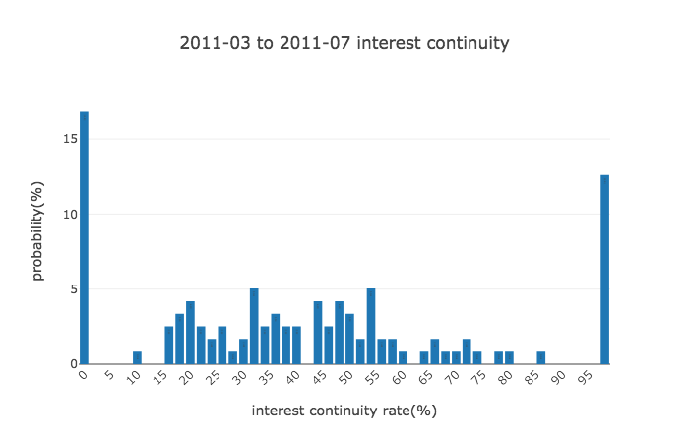
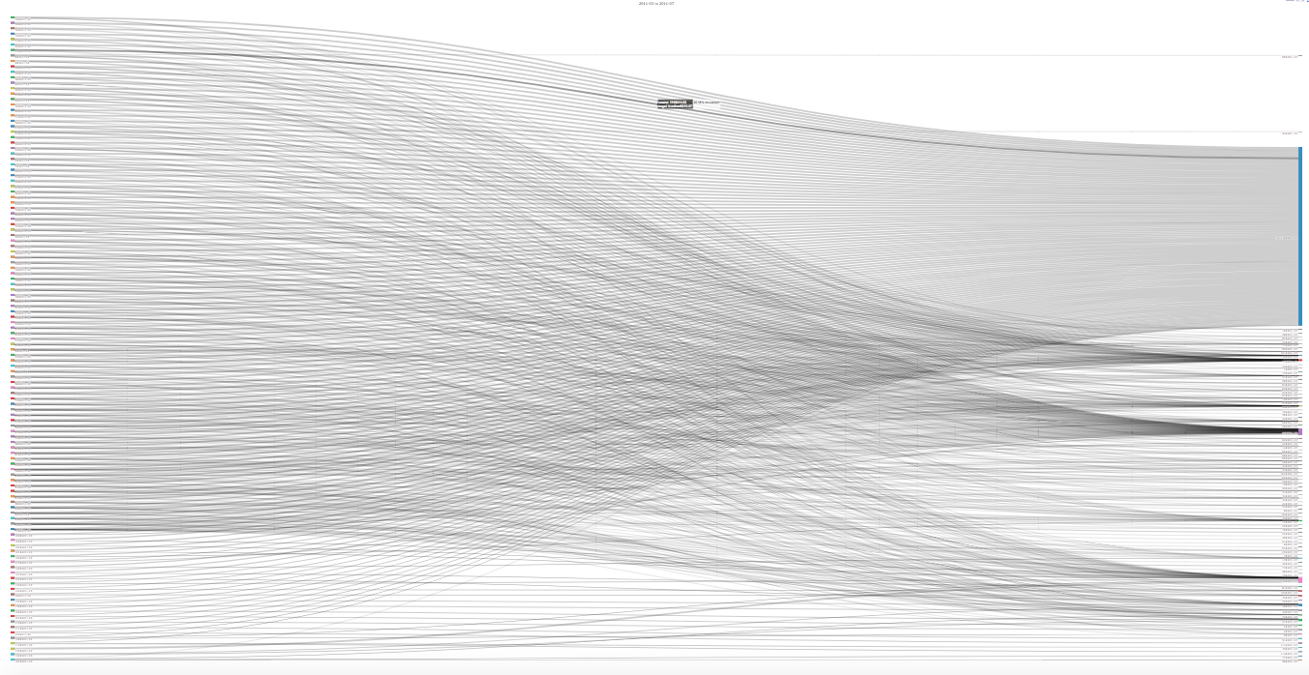
3.4 2011-03 to 2011-07 (Fast-Growing Era)
Notes:
Interestingly, this graph looks much less dense as the flow has nearly halved to 5.97, whereas the user growth has shot up to roughly 100,000 users.
Interestingly, you start to see the development of bi-model distribution (people either constantly changing interest category or not). Thus, there is a polarized divide in user interest continuity
If Reddit was purely a discussion forum and exhibited discussion forum behavior, then we would expect for the majority of users to remain in the same major interest category across snapshots.
Nevertheless, clearly, half of the communities of Reddit will change categories and interact with other users in different categories, suggesting the OSN behavior of Reddit.
Therefore, Reddit seems to act as a OSN for those who want to use it as such and interact together with other users in different categories.

Slide 16
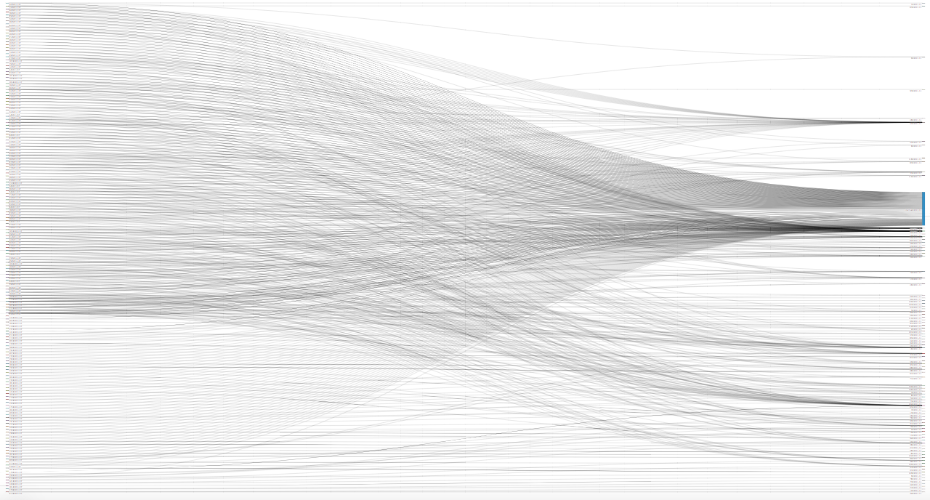
Outgoing Flow: 3.7
2011-07 to 2011-11
Users: ~160,000
Notes:
The following snapshot (similar pattern)

Slide 17
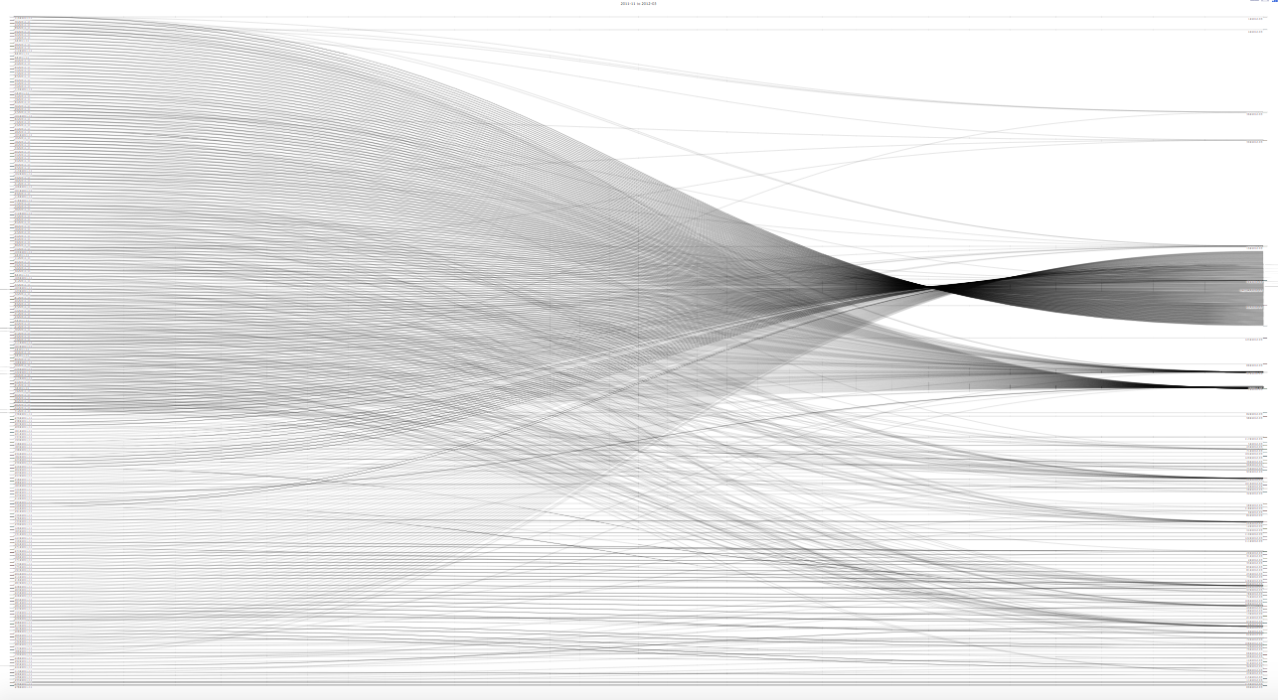
Outgoing Flow: 3.7
2011-11 to 2012-03
Users: ~230,000
Notes:
The following snapshot (similar pattern)

Slide 18
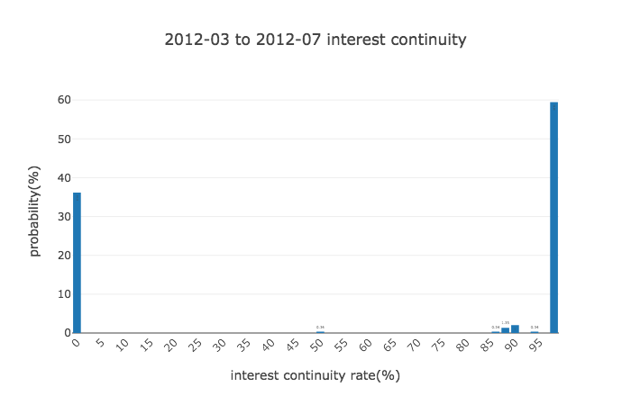
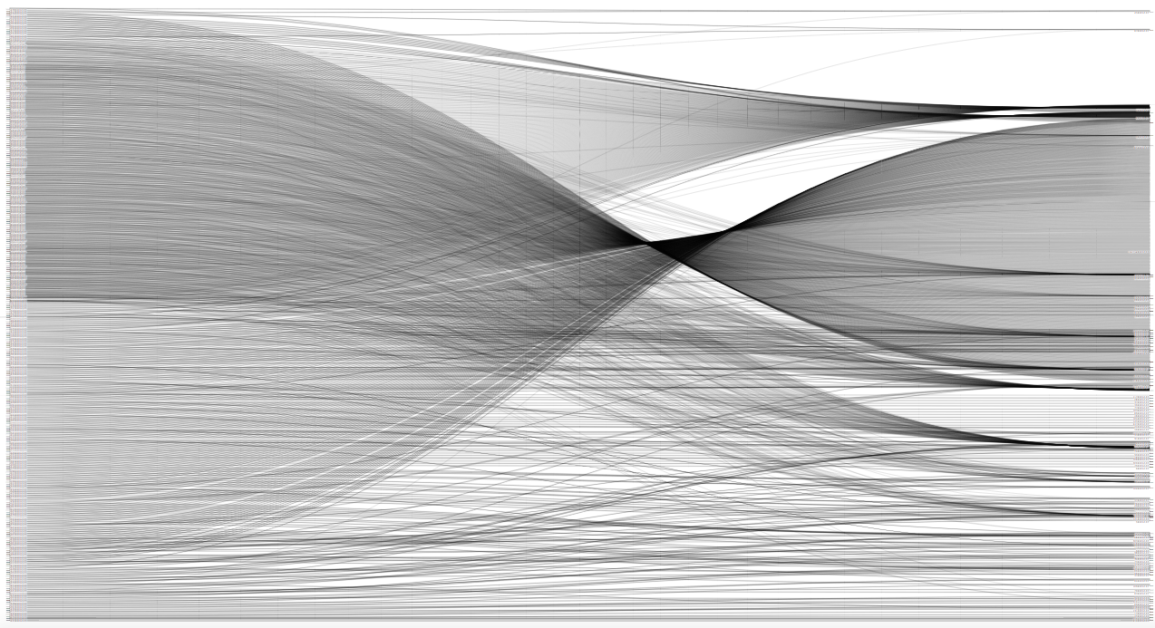
3.5 2012-03 to 2012-07 (Post-Explosion Era)
Notes:
Users: ~350,000, mean outgoing flow is 3.02
Hard to visualize because reached peak number of users, but there is still large straight patterns, indicating the large number of clusters staying the same (½): also shows up in the probability distribution graph
And again, still observe that majority of the clusters are dropping out: a drop out rate of 89% of a cluster dropping out in the time frame from 2008-07 to 2008-11, compared to a 70% drop out rate from 2012-03 to 2012-07 (also especially notable because of the high deviations of 21.00 compared to 6.57 in the earlier snapshot, indicating that the dropout rate varies widely.
Significant number of clusters with 0% dropout rate

Slide 19
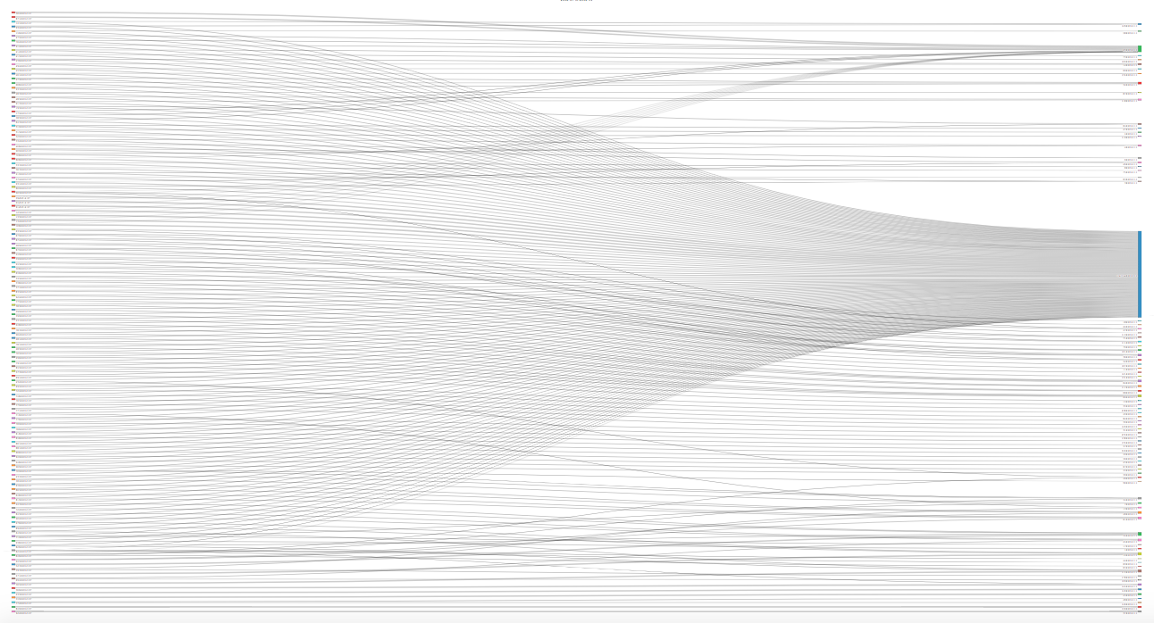
Outgoing Flow: 3.96
2012-07 to 2012-11
Users: ~350,000 to ~130,000
Notes:
This is our final snapshot (lower user number makes it viewable)
The bipartite behavior of the graph is particular notable, with many clusters staying the same through the snapshot
Nevertheless, interestingly, the cluster with the largest number of categories has 416 categories, which strongly suggests the formation of a mini social network in Reddit (the average number of categories is usually 1-3 for earlier snapshots, 4-7 for intermmediate ones, and 11-31 for our later snapshots (in a sense users in reddit are becoming more connected to different categories/exposed to different categories overtime)
In contrast, in the same snapshot, there are also multiple clusters with only 1 or 2 categories. Thus, this suggest the formation of almost a mini-social network for clusters with a larger number of categories, and a isolated discussion post behavior for clusters with only 1 or 2 categories.

Slide 20
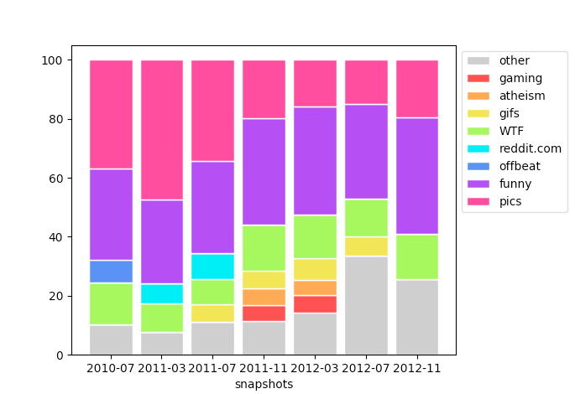
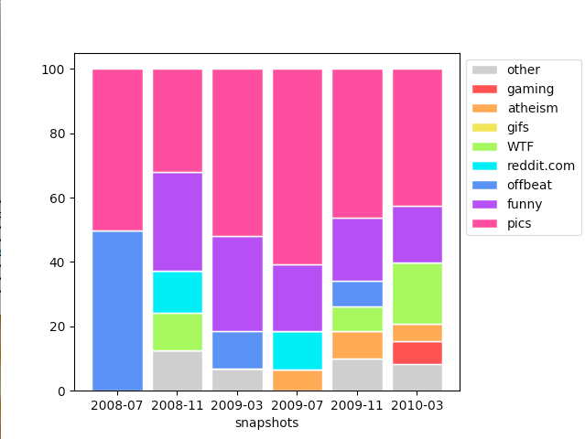
3.6 Top Categories Breakdown
A small set of categories dominate
Some categories come and go
Some have enduring popularity once introduced
Notes:
A small set of categories dominate
Some categories come and go
Some have enduring popularity once introduced

Slide 21
4 Conclusion
We analyzed how users’ interests shift over time
We find that Reddit exhibits properties of traditional OSNs
User interest shifts polarize as Reddit develops, half sticking with one interest community, the other half constantly changing interests
Overall user interests clearly change dynamically and shifts throughout the snapshots
Fin
Notes:
We analyzed how users’ interests shift over time
We find that Reddit exhibits properties of traditional OSNs
We propose that those who want to find OSN in reddit can, but for those who wish to stick to a certain topic of interest, Reddit certainly supports those users s well
User interest shifts polarize as Reddit develops, half sticking with one interest community, the other half constantly changing interests
Overall user interests clearly change dynamically and shifts throughout the snapshots

